Slide 1
Envisioning Neighborhood Futures After the Chinatown Stitch
Instructors: Michael Fichman & Matthew Harris
Team: Aki Di Sandro, Ray Ma, Luming Xu, Sijia Zhang, Yixuan Zhou
Client Contacts: OTIS

Slide 2
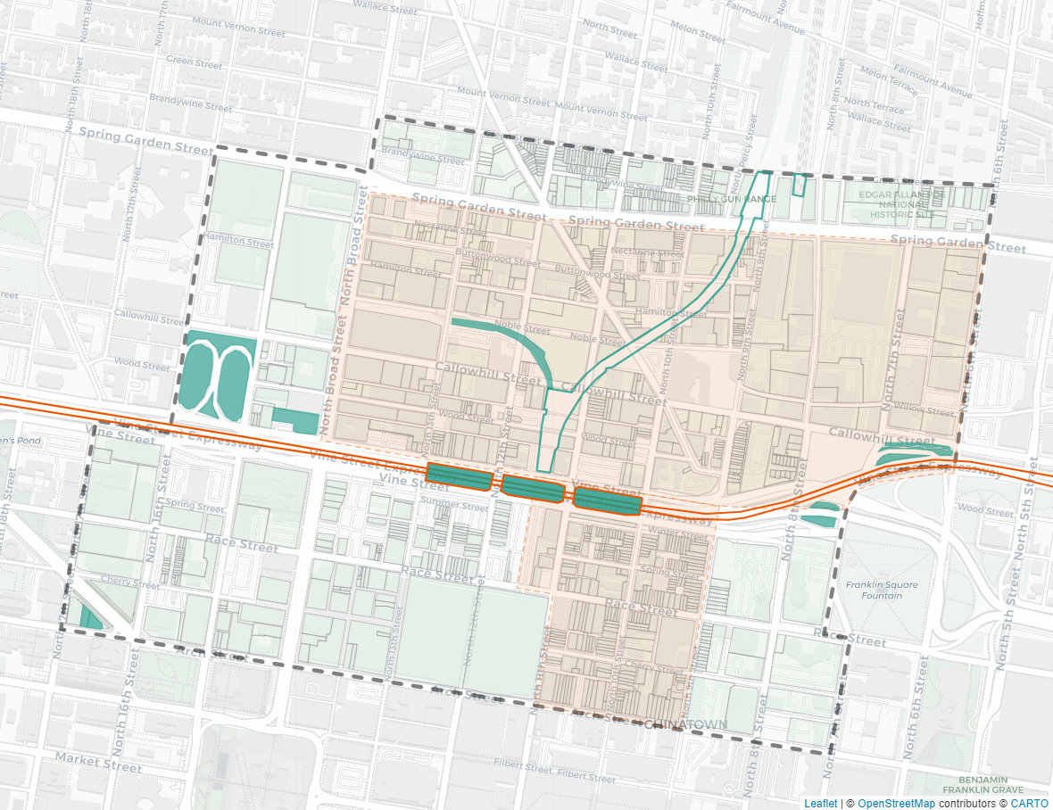
Use Case
Data - Driven Storymap
Objectives
Reveals alternative futures of housing market in Chinatown
Understand the potential effects of the Chinatown Stitch
Audience
OTIS
Local business owners
Community stakeholders
Notes:
Starting off with our use case. We will be Developing a data-driven story map that reveals three alternatives future of the house price market in the Philadelphia Chinatown after the implementation of the Chinatown Stitch project to inform OTIS, local business owners, and community stakeholders of its potential affects on the neighborhood.

Slide 3
Research
History Context (Neighborhood & Vine Street) /
Chinatown Stitch Project
Notes:
In this first part of presentation, we will provide some historical context about the neighborhoods, highway constructions, as well as the Chinatown Stitch project…

Slide 4
History Context
1800s - Mid-1900s
Industrial Growth and Infrastructure
1950s-1990s
Decline and Neglet
2000s-2010s
Revitalization and the Loft Movement
2018 - Present
Urban Renewal
and Future Prospects
Callowhill
Vine Street
1940s-1950s
Widening of Vine Street
1960s-1970s
Resistance&Obstacles
1980s-1990s
Improvements & Completion
2000s-Present
Maintenance Efforts
Chinatown
1870s-1930s
The Birth of Philadelphia Chinatown
1900s-1960s
Industrialization and Population Growth
1968-2000s
Resistance and Preservation
2000s - Present
Modern Development and Gentrification
Notes:
We will go through the history context of Vine Street, Chinatown and Callowhill quickly.

Slide 5
History Context
1800s - Mid-1900s
Industrial Growth and Infrastructure
1950s-1990s
Decline and Neglet
2000s-2010s
Revitalization and the Loft Movement
2018 - Present
Urban Renewal
and Future Prospects
Callowhill
Vine Street
1940s-1950s
Widening of Vine Street
1960s-1970s
Resistance&Obstacles
1980s-1990s
Improvements & Completion
2000s-Present
Maintenance Efforts
Chinatown
1870s-1930s
The Birth of Philadelphia Chinatown
1900s-1960s
Industrialization and Population Growth
1968-2000s
Resistance and Preservation
2000s - Present
Modern Development and Gentrification
Notes:
First lets focus on the 19th to mid 20th centuries…

Slide 6
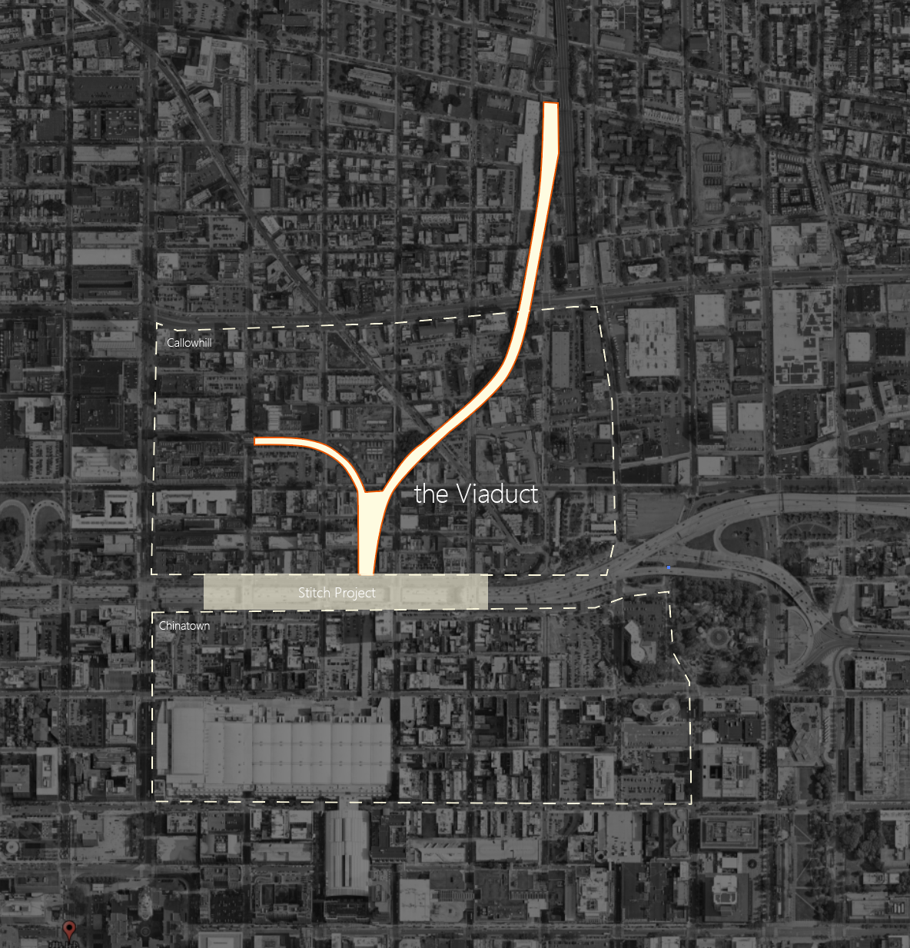
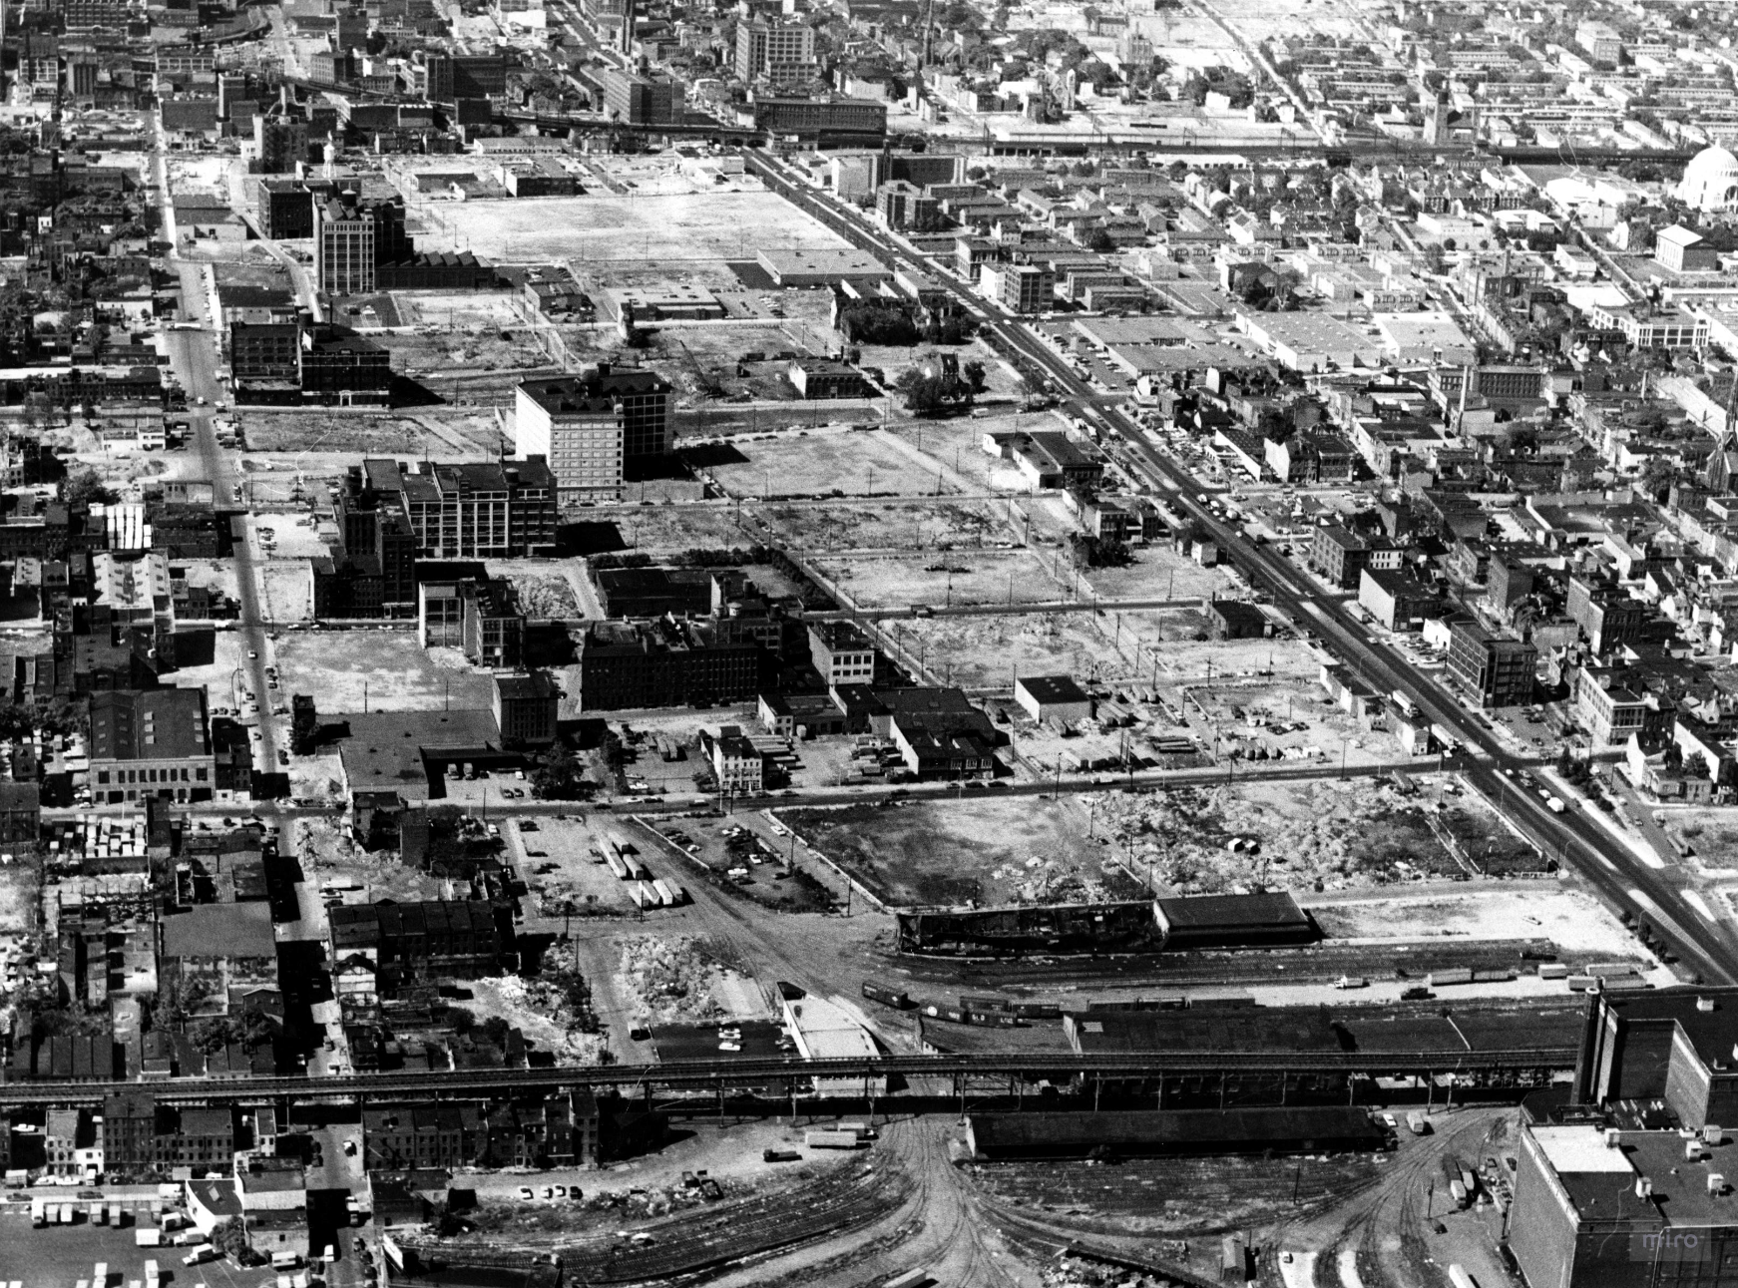
1800s - Mid-1900s
Industrial Growth and Infrastructure
Callowhill was originally an industrial hub with factories, warehouses, and rail infrastructure.
The Reading Viaduct, built in the late 19th century, helped support manufacturing and trade.
Industrial decline began after World War II, leading to vacant buildings and economic downturn.
Notes:
Callowhill was a major industrial hub with factories, warehouses, and rail infrastructure, supported by the Reading Viaduct. However, after World War II, industrial decline led to economic downturn, leaving many buildings vacant.

Slide 7
History Context
1800s - Mid-1900s
Industrial Growth and Infrastructure
1950s-1990s
Decline and Neglet
2000s-2010s
Revitalization and the Loft Movement
2018 - Present
Urban Renewal
and Future Prospects
Callowhill
Vine Street
1940s-1950s
Widening of Vine Street
1960s-1970s
Resistance&Obstacles
1980s-1990s
Improvements & Completion
2000s-Present
Maintenance Efforts
Chinatown
1870s-1930s
The Birth of Philadelphia Chinatown
1900s-1960s
Industrialization and Population Growth
1968-2000s
Resistance and Preservation
2000s - Present
Modern Development and Gentrification
Notes:
Chinatown had a slightly different story at that time…

Slide 8
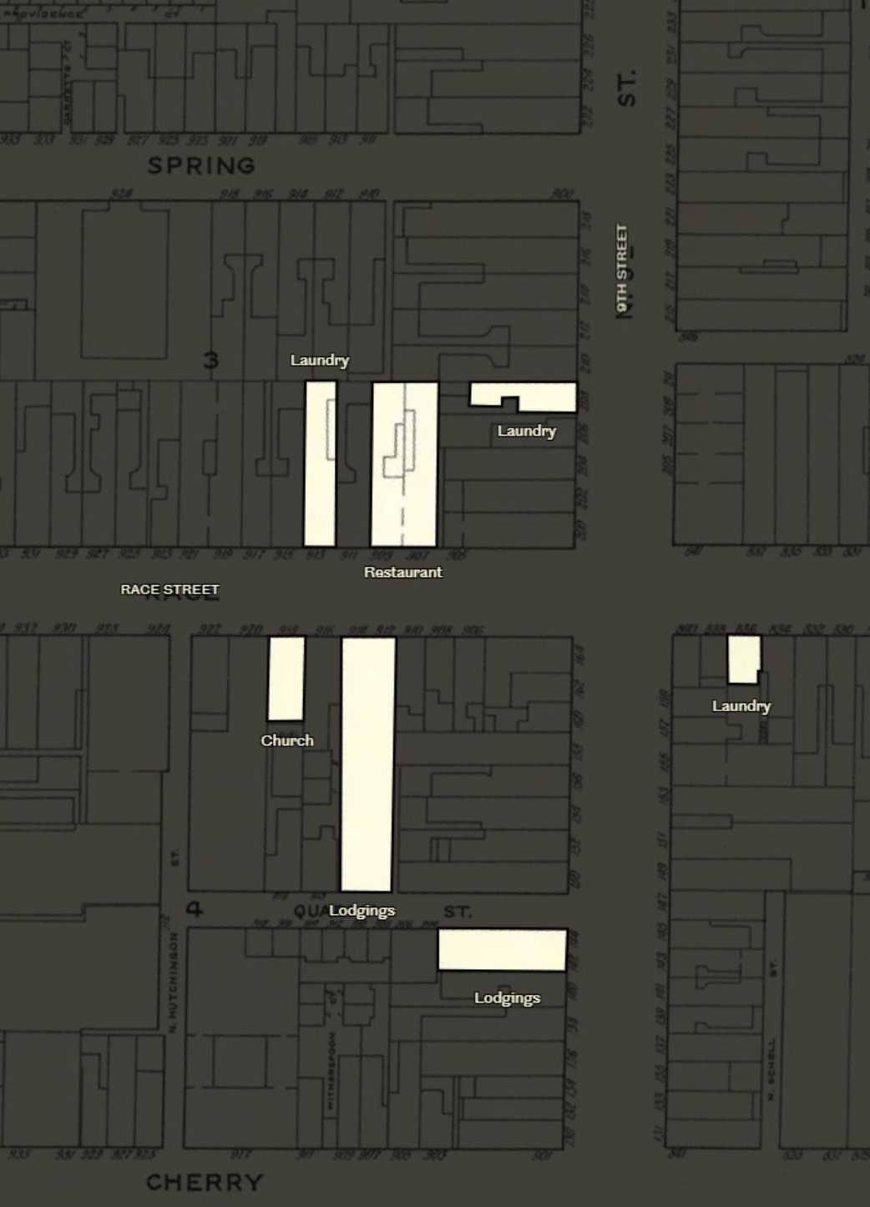
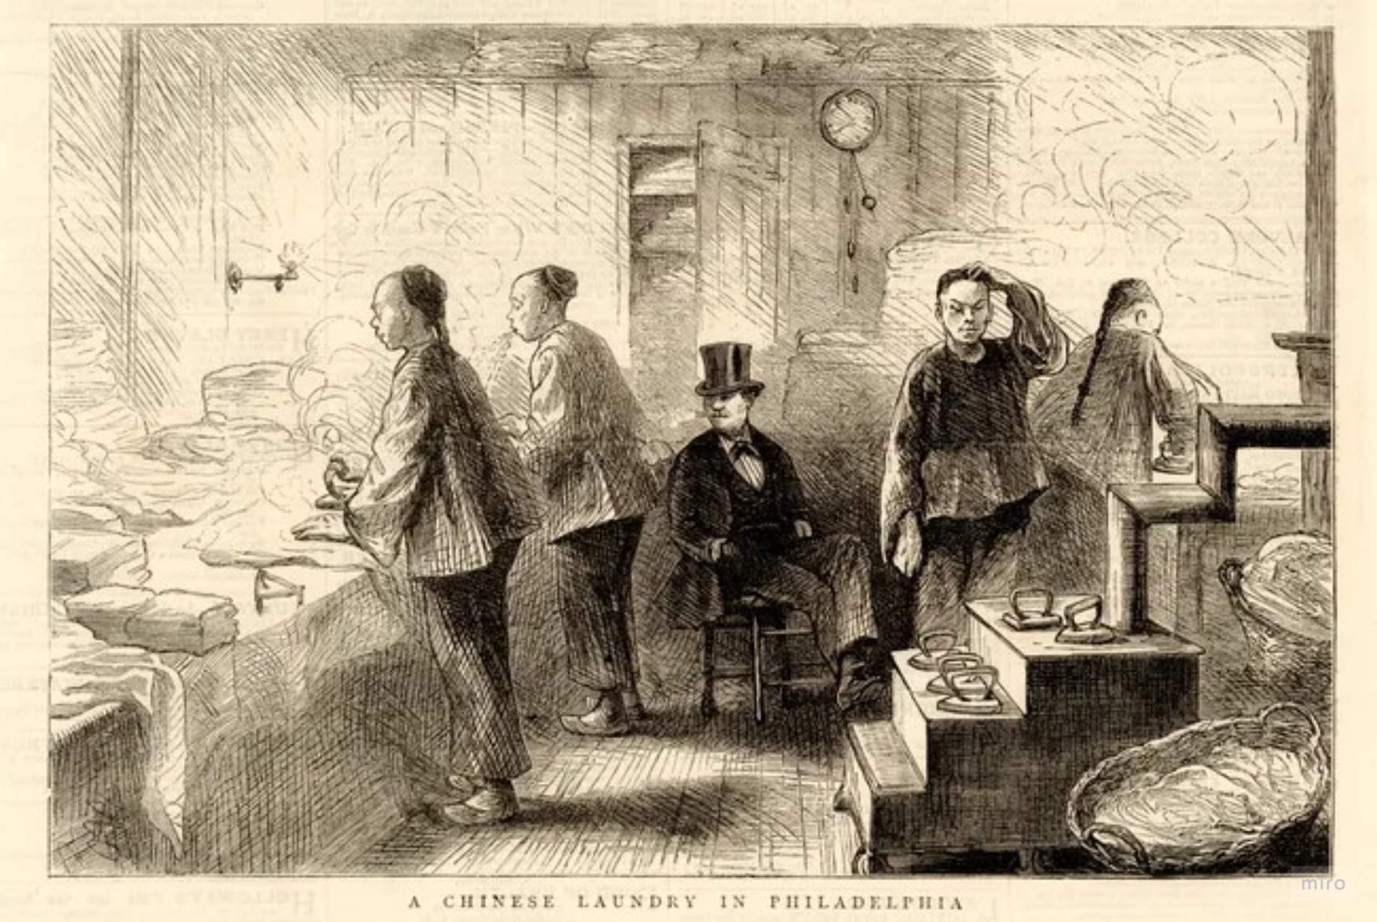
1870s - 1930s
The Birth of Philadelphia Chinatown
Chinatown emerged in the 1870s as Chinese immigrants, facing hostility in the West, established a small community centered around Race Street.
The first Chinese-owned business, Lee Fong’s laundry, opened in 1871, leading to the rise of laundries, restaurants, and grocery stores.
Notes:
Philadelphia's Chinatown was established in the 1870s by Chinese immigrants seeking refuge from hostility in the West. It is started from some laundries, restaurants and grocery stores.

Slide 9
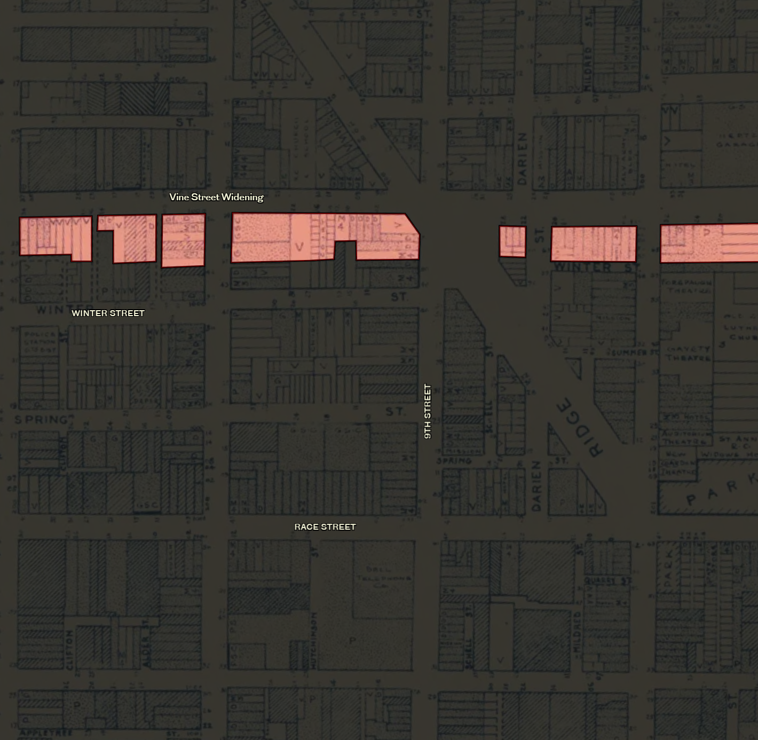
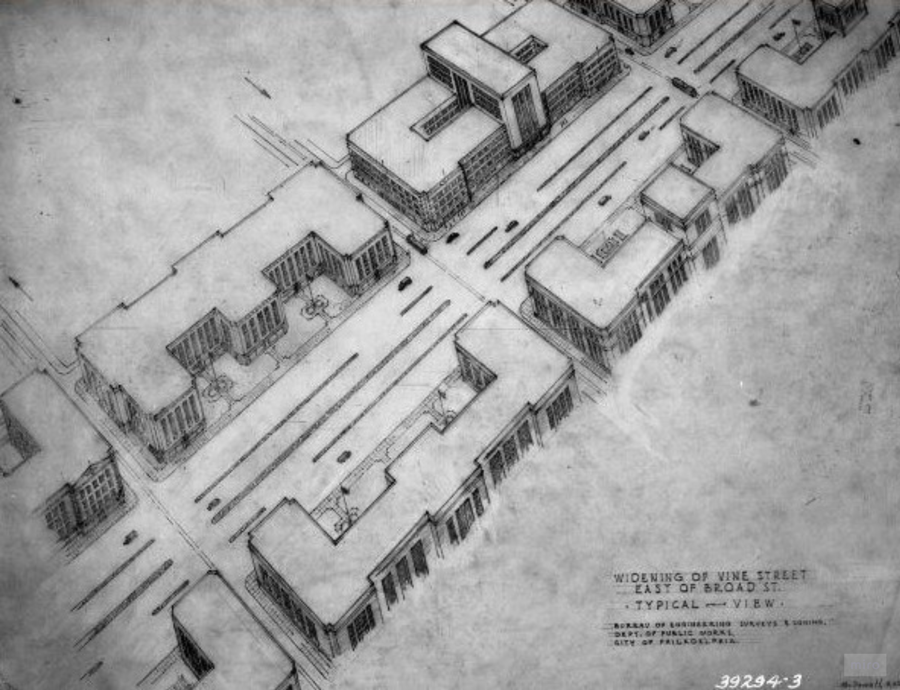
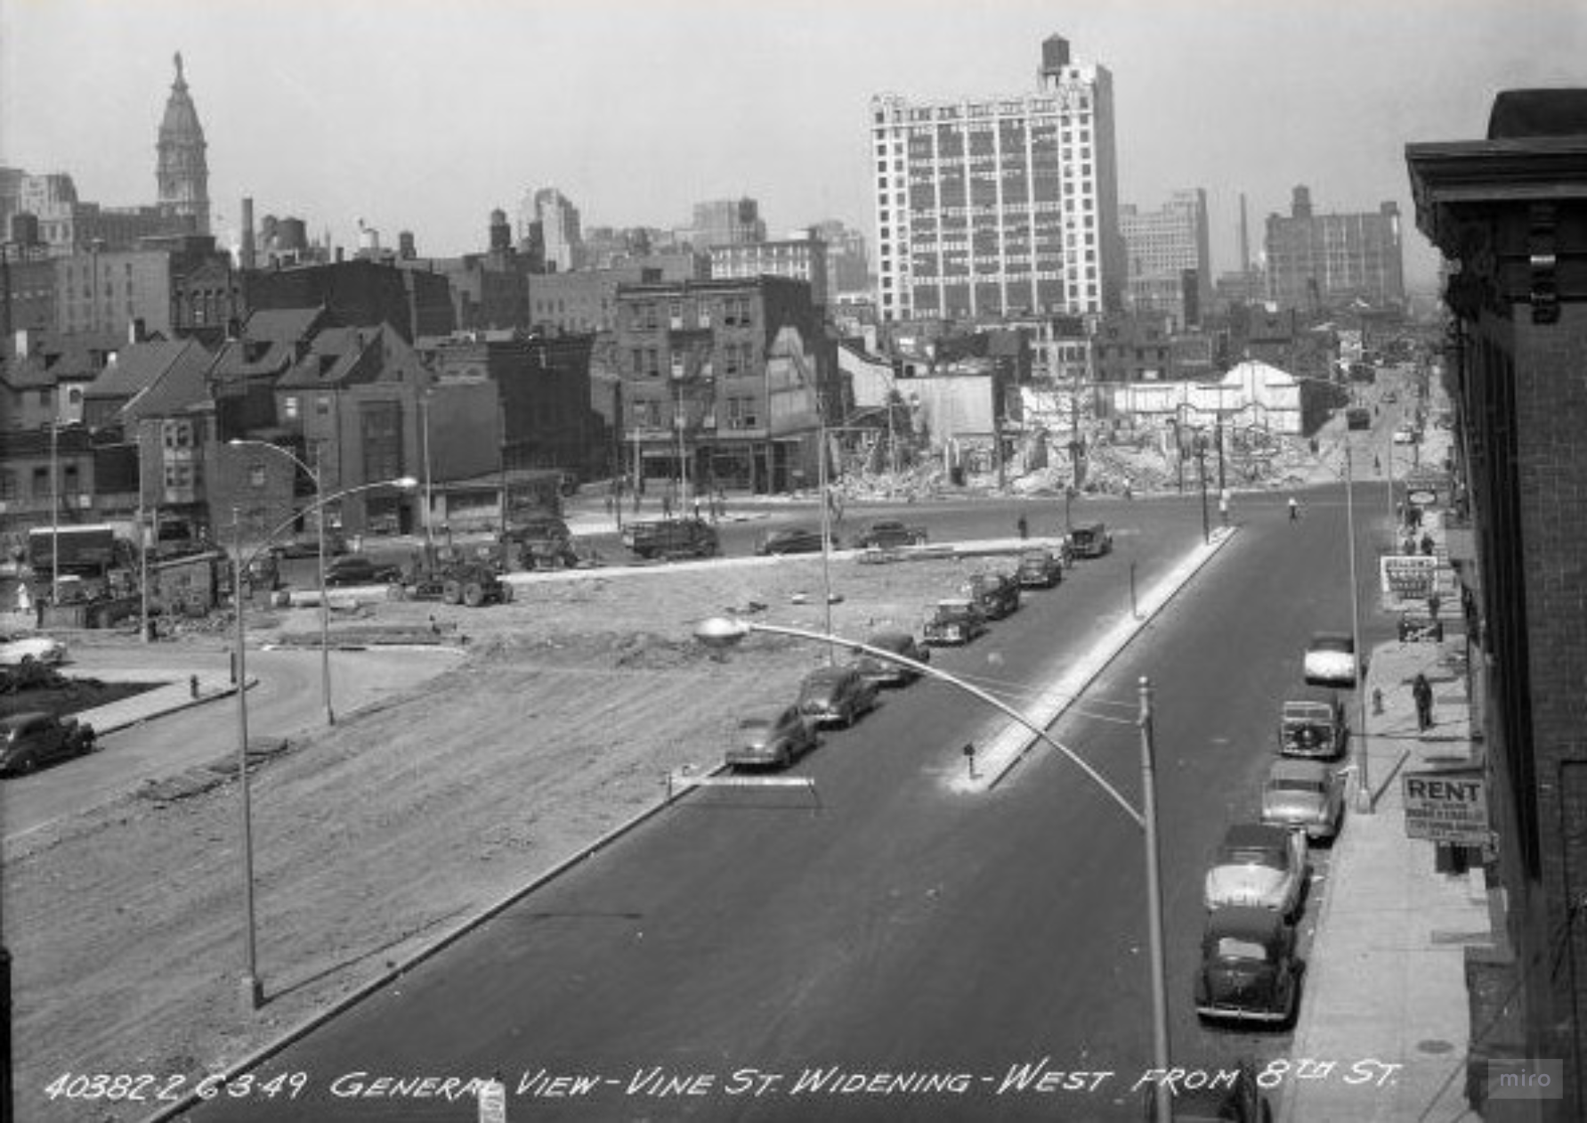
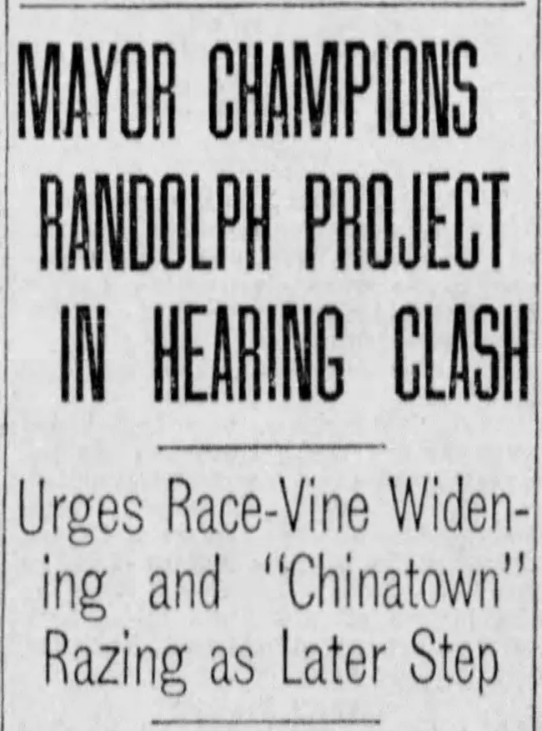
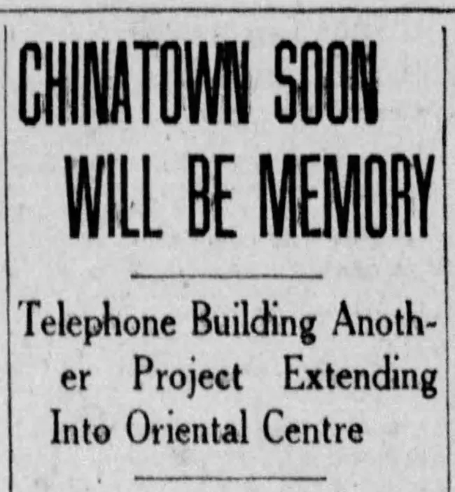
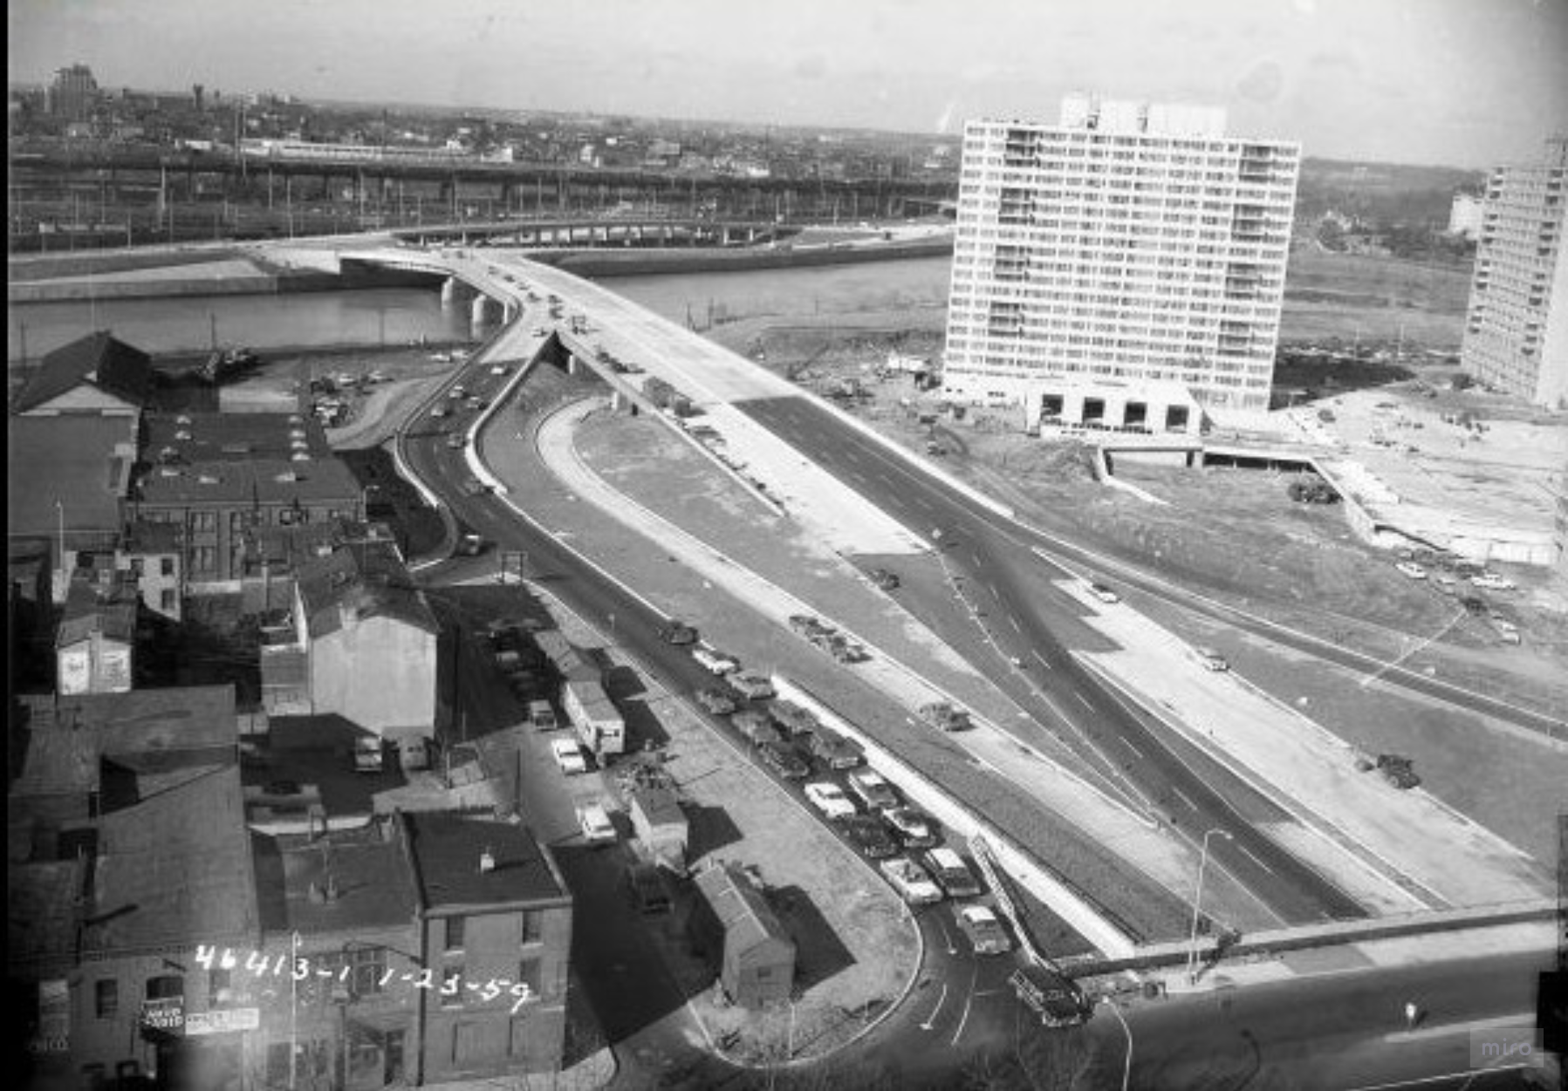
CHINATOWN
1900s-1960s
Industrialization and Population Growth
VINE STREET
1940s-1950s
Widening of Vine Street
1947 - City planners Ed Bacon and Oscar Stonorov’s “Better Philadelphia”: idea of widening the vine street
1951 – Vine Street expanded to ten lines
1956 – Vine Street Expressway designated as an interstate highway
Chinatown slowly expanded, but anti-Asian discrimination and restrictive housing policies kept it confined to a small area.
Urban renewal projects, including the construction of the Vine Street Expressway and the Pennsylvania Convention Center, threatened the neighborhood’s survival.
The community faced housing demolitions and displacement due to these large-scale infrastructure developments.
Notes:
During the mid-20th century, Chinatown faced restrictions on expansion due to anti-Asian discrimination and housing policies. Large-scale urban renewal projects, including the widening of Vine Street and the construction of the Vine Street Expressway, led to housing demolitions and displacement, threatening the neighborhood’s survival and reshaping its landscape.

Slide 10
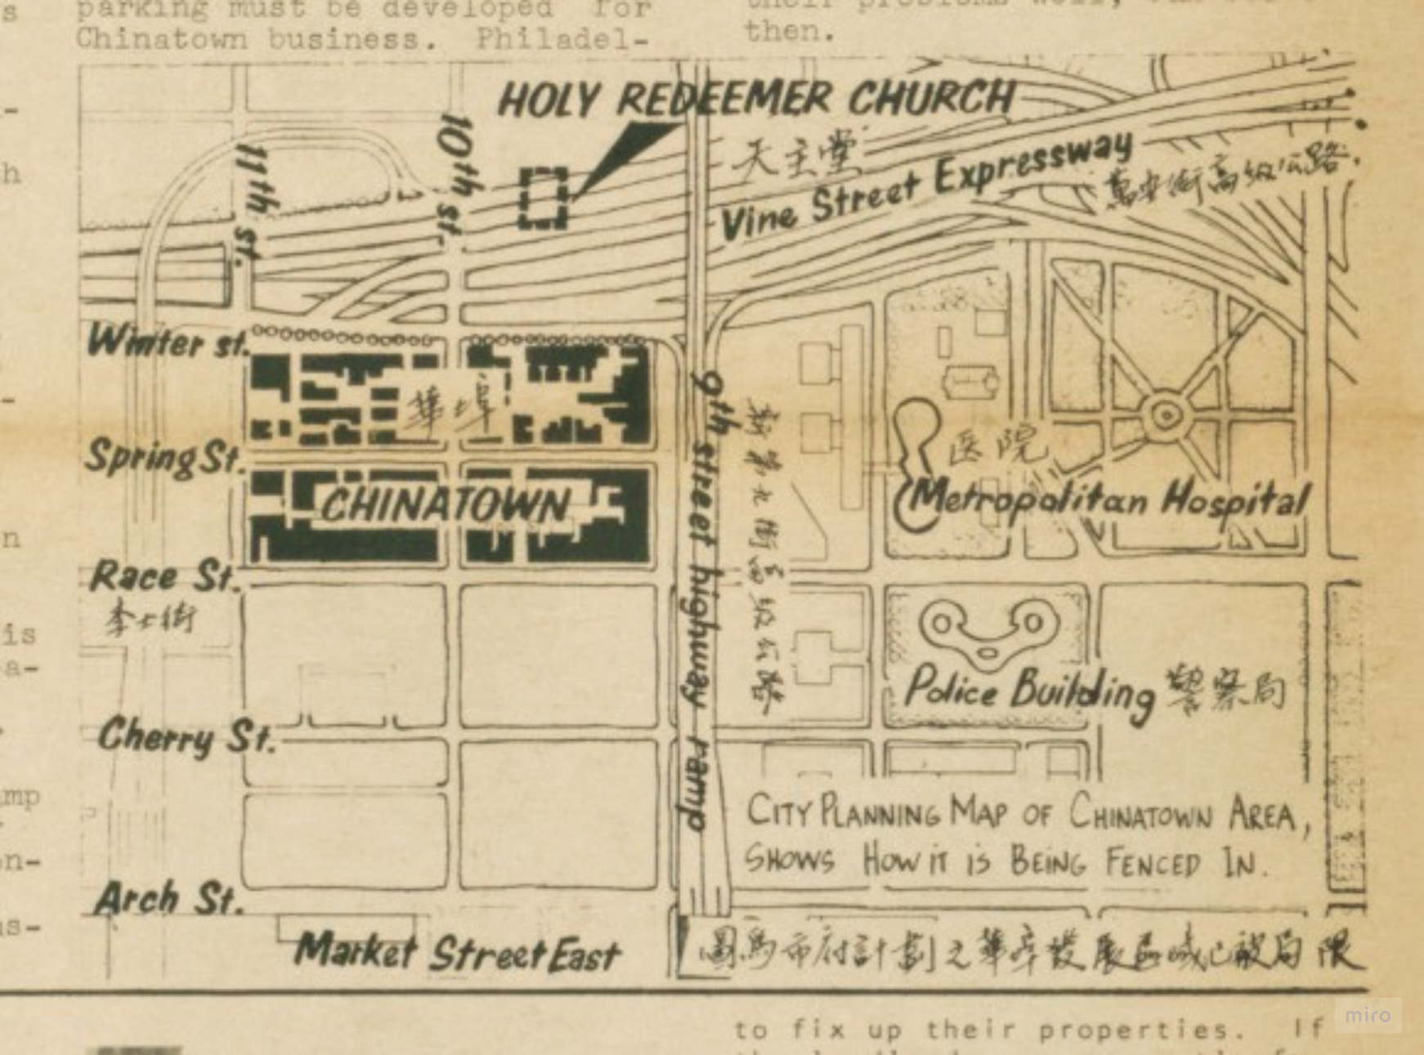
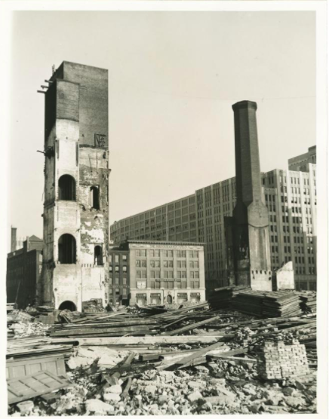
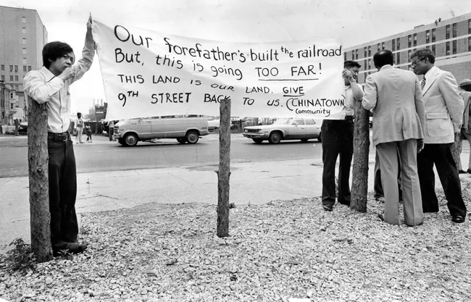
Callowhill experienced severe decline due to deindustrialization. Many warehouses remained underutilized, serving as storage or becoming vacant.
Baldwin Locomotive Works plant in 1937, signaling the downfall of major industrial operations in the area
The Philadelphia Chinatown Development Corporation (PCDC) was founded in 1968 to advocate for Chinatown's preservation.
Urban renewal efforts in the 1970s demolished entire blocks, displacing residents and replacing the area with parking lots and institutional structures.
The Vine Street Expressway underwent critical development and was finally completed, iisolating the Callowhill from Chinatown and the city center.
Notes:
The construction of the Vine Street Expressway further isolated Callowhill from Chinatown, exacerbating the effects of deindustrialization. While Chinatown resisted urban renewal threats and expanded northward, Callowhill faced economic decline, with abandoned warehouses and population loss following the downfall of major industries like Baldwin Locomotive Works

Slide 11
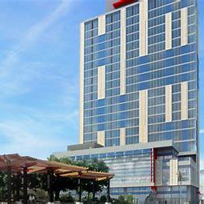
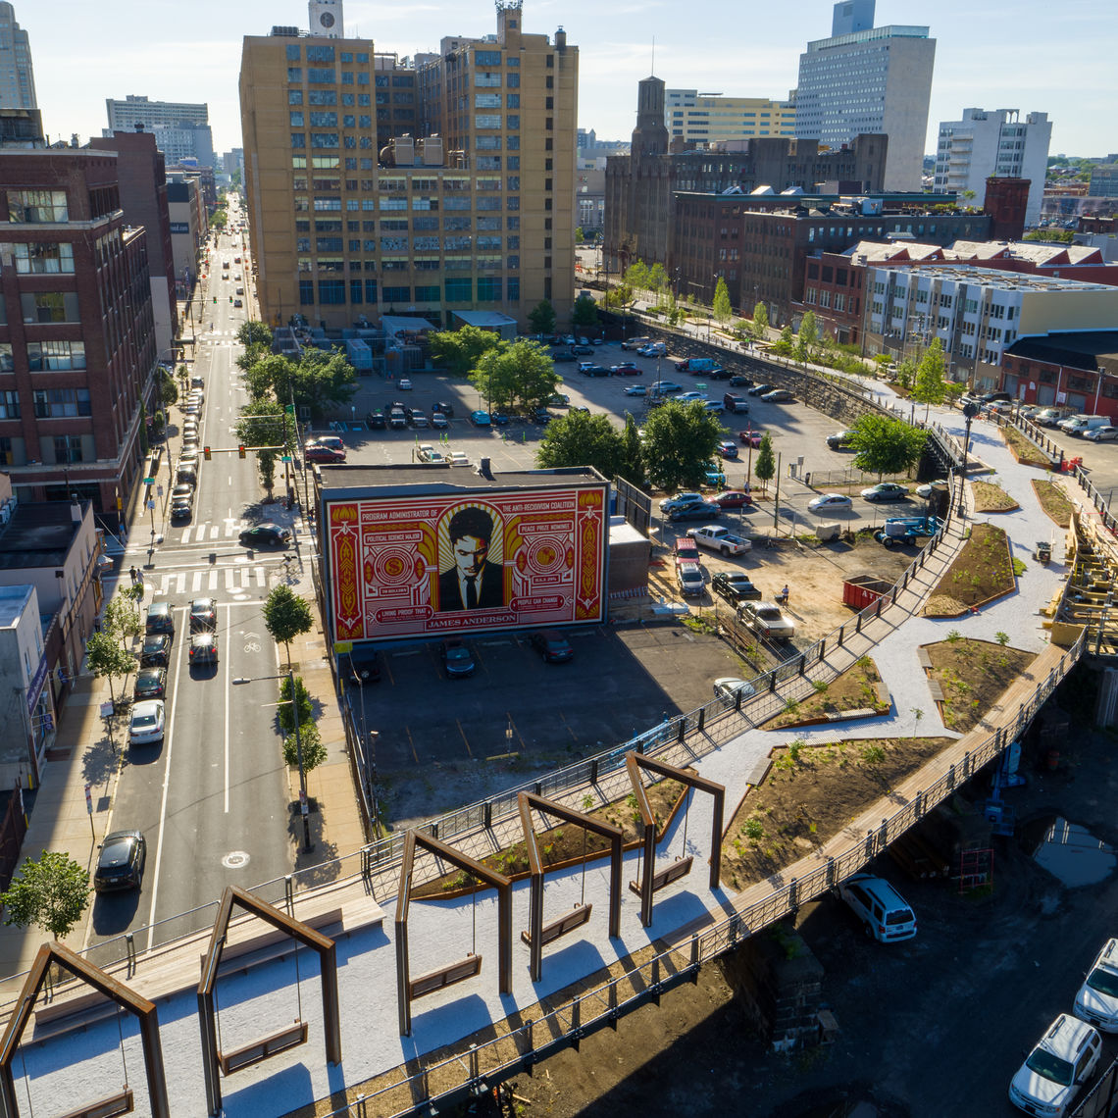
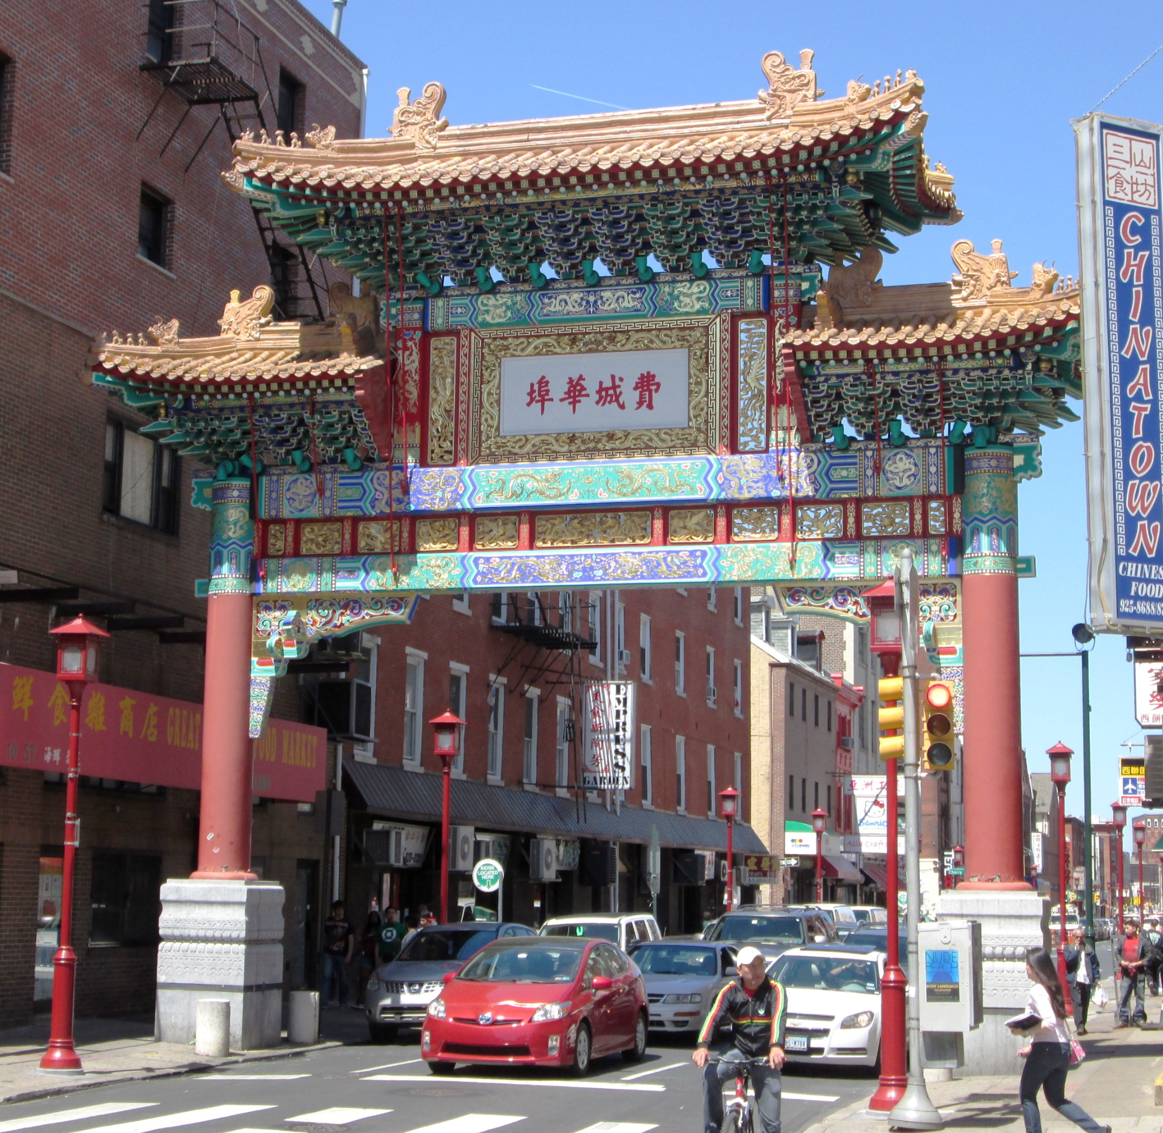
Callowhill: 2000s-2010s
Revitalization and the Loft Movement
Callowhill: 2018 - Present
Urban Renewal and Future Prospects
Chinatown: 2000s - Present
Modern Development and Gentrification
1. The 1st phase of the Rail Park opened in 2018 increasing property values and attracting businesses
2. Growing concern over gentrification as luxury developments continue to rise
1. Continued growing with the addition of apartment buildings, supermarkets, and cultural institutions
2. Recently, the community has resisted a proposed $1.3 billion 76ers basketball arena, fearing displacement and cultural erosion.
1.“The Loft District”:
Old industrial buildings -> Loft apartments
2. The Reading Viaduct -> Rail Park
3. Artists and creative professnionals moved in.
Notes:
As of today, Callowhill has transformed into a vibrant residential and creative hub, with old industrial buildings repurposed into loft apartments and the Rail Park enhancing urban appeal. Meanwhile, Chinatown continues to grow with new developments while actively resisting gentrification threats, such as the proposed 76ers basketball arena.

Slide 12
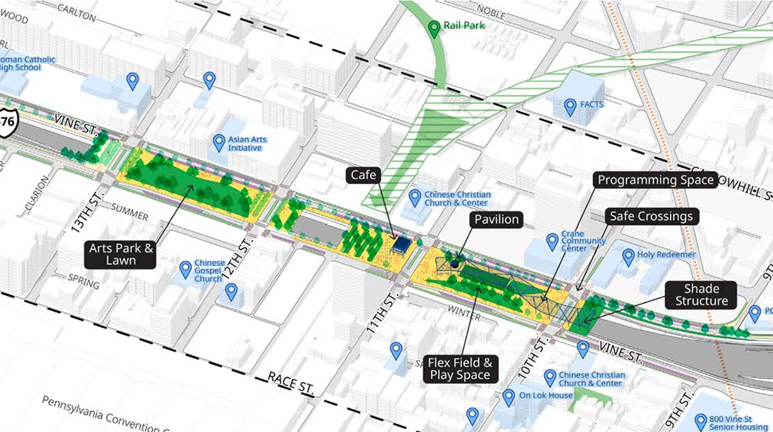
The Chinatown “Stitch” Project
Financing
$1.8M from US Department of Transportation
$2.2M from the City and local partners
$158M from US Department of Transportation Neighborhood Access and Equity grant
Implementation Timeline
2023 Community Engagment and Survey
2024 - 2026 Design and Engineering
2027 - Construction starts
2030 - Expected to be completed
Cost
Phase I costs about $160M
~$575/sq-ft across the entire project area
$950/sq-ft (in 2023 dollars) for capped area
Notes:
Therefore, to solve some of the negative effects such as disamenities and economic inequality brought by the development of construction of the Vine Street Expressway, the plan of a Chinatown Stitch Project was put in place…
The Chinatown Stitch Project is a recreational project that seeks to reconnect the neighborhoods North and South of the highway by capping sections of the Vine Street Expressway between 10th and 13th streets.
The Phase One of the project, shown in the illustration, cost about 160 million dollars and is funded mostly by the US Department of Transportation as well as the city and its local partners.
The project is currently in the design and engineering stage right now as the construction will begin in 2027 and the phase one of the project is expected to be completed in early 2030.

Slide 13
Methodology
Case study / Data Resources / EDA / Models / Results
Notes:
Next, we will get into our methodology…

Slide 14
Methodology
Exploratory Data Analysis (EDA)
Data Wrangling
Predictive Modeling
Story Map
Feature engineering
Study areas
Property data
Census data
Neighborhood context
Social survey
Basic geography
Sales price change
Highway effects on sales price
Case studies
OLS regression model
Regression discontinuity models
Predictive model
Background information
The Stitch effects on sales price
Three future scenarios
Quantitative relationships between the I-676 and sales price
Sales price interpretations of the northern and southern side of I-676
Predicting sales price based on future scenarios
Software: R, ArcGIS Pro, JavaScript
Notes:
Here is a breakdown of the framework of our project…

Slide 15
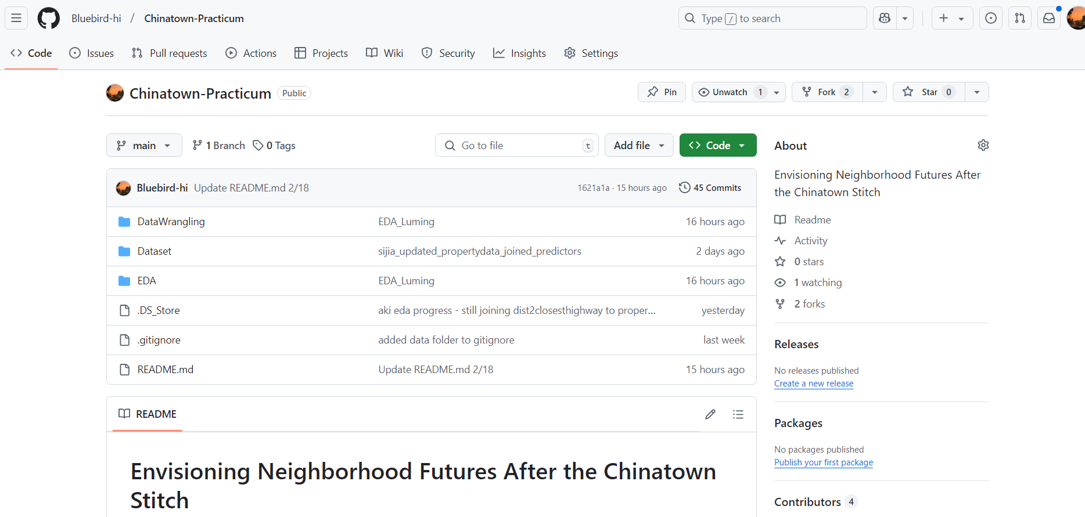
Github
GitHub: Bluebird-hi/Chinatown-Practicum: Envisioning Neighborhood Futures After the Chinatown Stitch

Slide 16
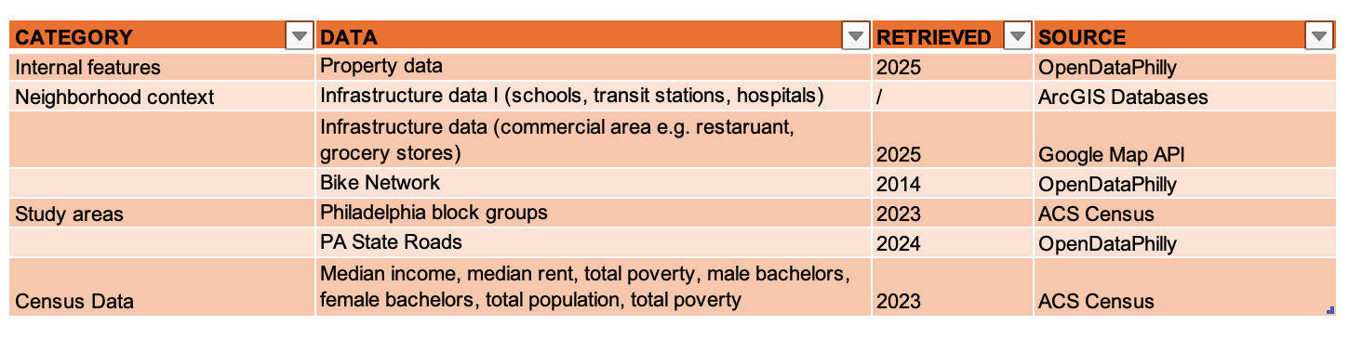
Data Wrangling: Data Source
CATEGORY | DATA | RETRIEVED | SOURCE
Internal features | Property data | 2025 | OpenDataPhilly
Neighborhood context | Infrastructure data I (schools, transit stations, hospitals) | / | ArcGIS Databases
 | Infrastructure data (commercial area e.g. restaruant, grocery stores) | 2025 | Google Map API
 | Bike Network | 2014 | OpenDataPhilly
Study areas | Philadelphia block groups | 2023 | ACS Census
 | PA State Roads | 2024 | OpenDataPhilly
Census Data | Median income, median rent, total poverty, male bachelors, female bachelors, total population, total poverty | 2023 | ACS Census Data

Slide 17
Case Studies - Other caps
Qualitative Summary
Like Philly, many other cities constructed highways in ways that have negatively impacted communities of color and working class people (I-35 in Austin Texas displaced many Black and Latine residents; I-75/I-85 led to the loss of historic Black neighborhoods; Crosstown Freeway ran through the center of Asian ethnic enclaves).
Caps and similar improvements generally seem to increase neighborhood connectedness (removing barrier effects of highways) and green space, but many critics say that intentional planning and community partnerships are necessary to avoid the same communities the were harmed in highway construction to be displaced by gentrification that is likely to follow cap projects (due to increased property value).
Notes:
By studying other highway capping projects, we found that…
Highways in the US had been constructed in ways that negatively impacted communities of color and working class people
and even though caps and other forms of improvements increase can solve some of the problems, stratgitical planning needs to be in place to avoid problems such as gentrification

Slide 18
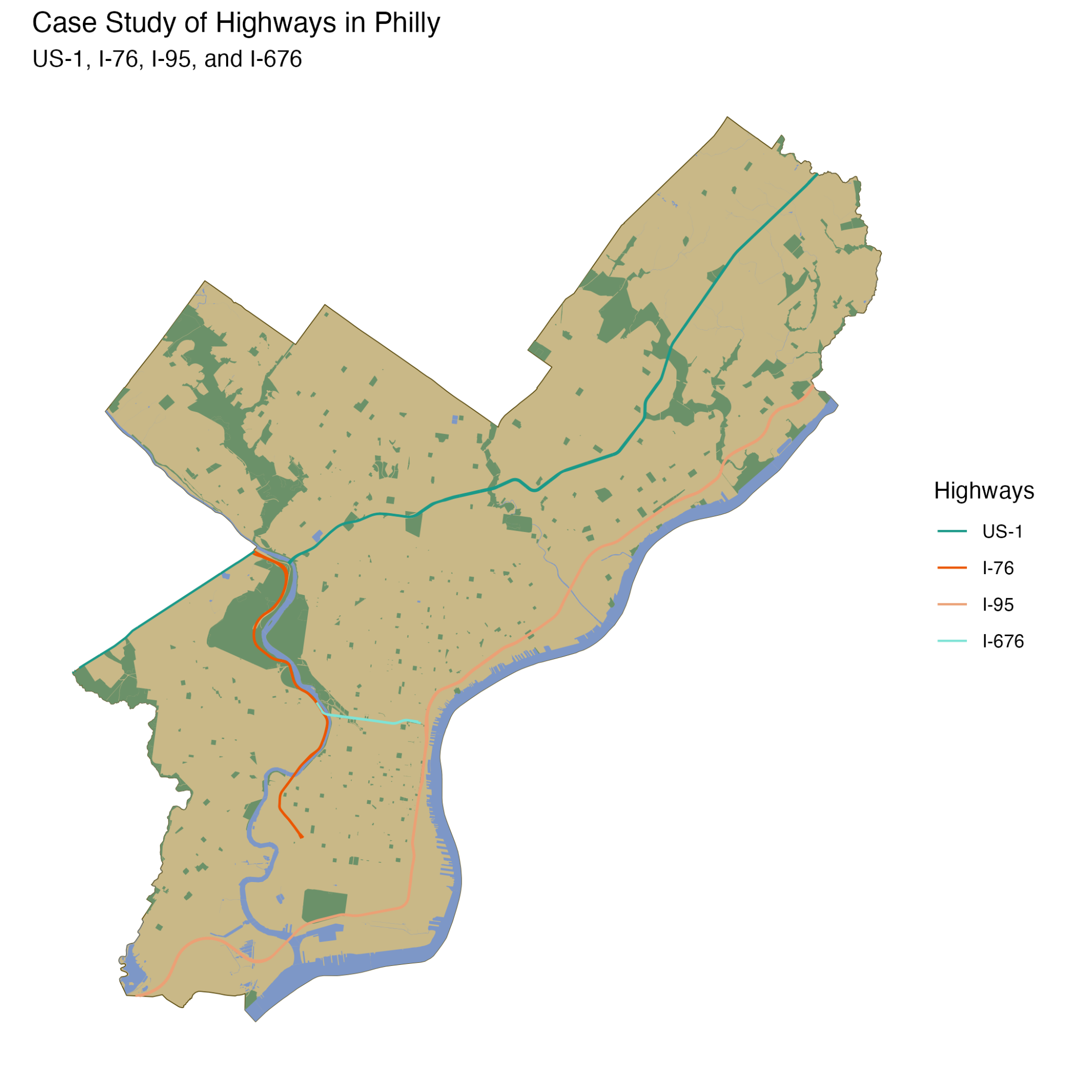
Case Studies - Highway effects on sales price
Qualitative Summary
Highway construction often benefits suburban neighborhoods by virtue of increased access to business centers, commercial areas, etc. (Lin and Brinkman, 2022)
Urban neighborhoods near highways often see lower land values and population loss (Mohl, 2008)
Price changes from highway construction take time to realize (Murray and Bardaka, 2021; Chernobai et al., 2009), but some effects are seen even prior to construction due to “public anticipation effects” (Levkovich et al., 2015).
Notes:
We also found out that…
Suburban neigborhoods seem to benefit more from highway constructions
Population and land values tend to decline in urban neiborhoods near highways

Slide 19
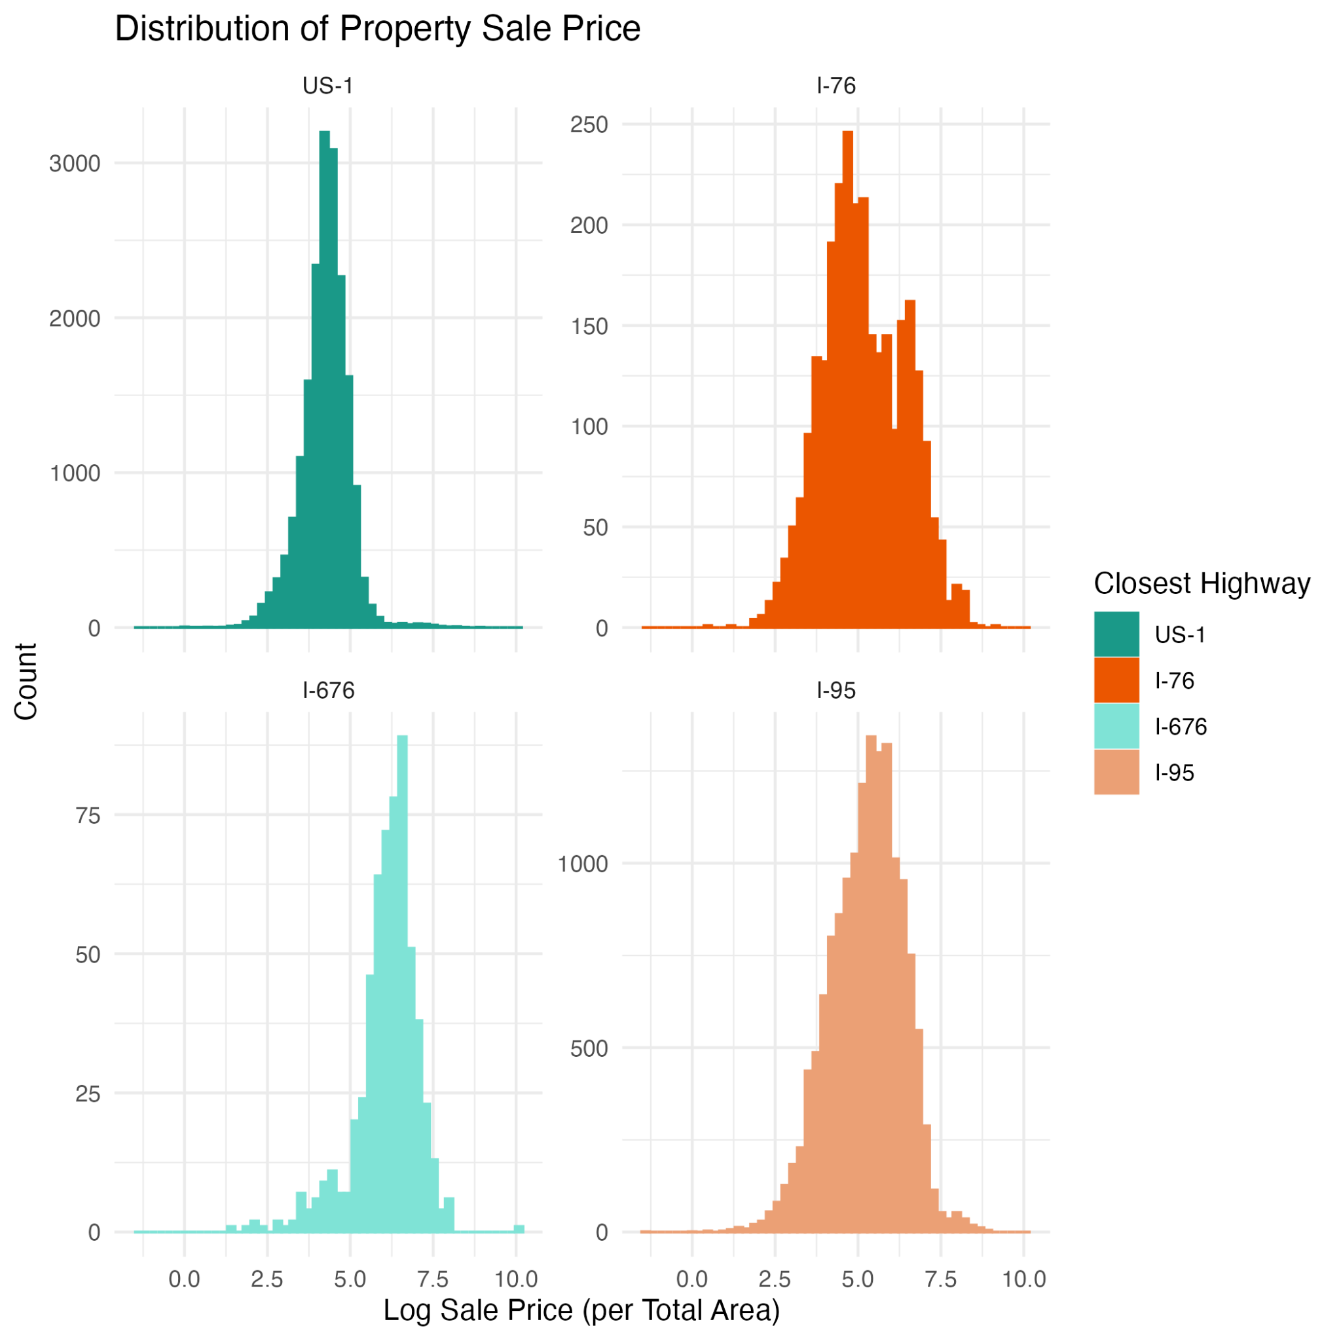
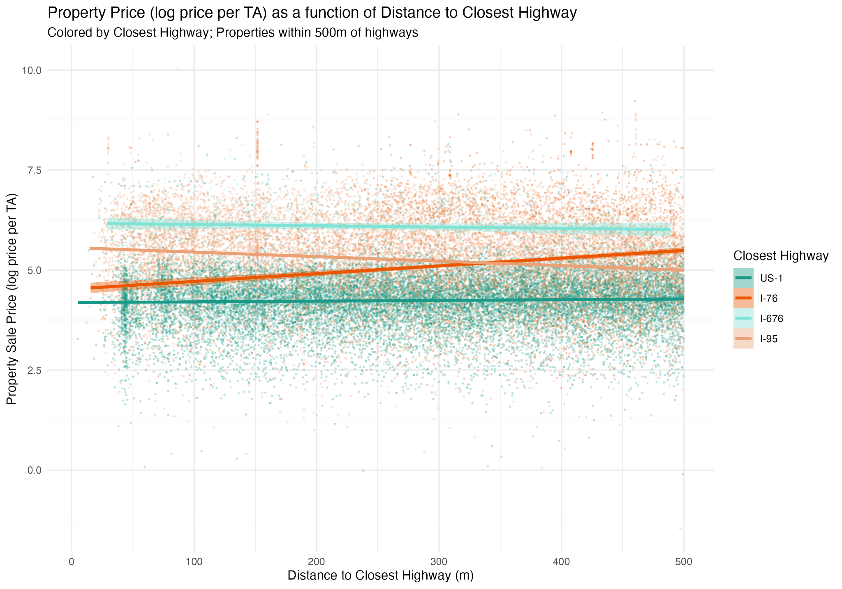
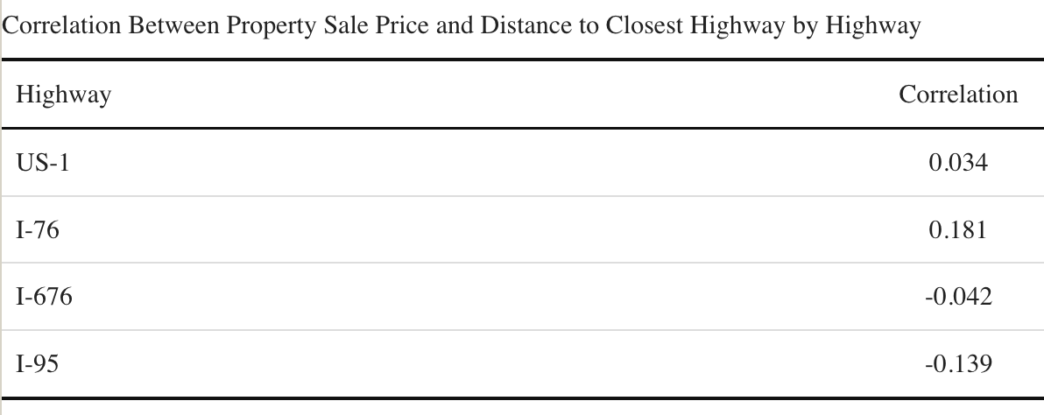
Case Studies - Highway effects on sales price
Notes:
We then took a look of the major highways in Philadelphia and how they affects surrounding neighborhood’s sales price…
We found that
interpretation:
property sale prices are generally higher around I-676. We attribute this to the highway and properties being in or very close to center city
The trend with properties 500m within I-76 support what we’ve read in the literature with a positive relationship between price and distance to highway
US-1 and I-676 show a relatively flat relationship
Properties close to I-95 display a trend opposite from what we expect. We suspect that the elevated nature of I-95 as well as the proximity to recently developed and historically significant properties near the highway are driving this relationship (but that is just what we are guessing)
notes about the data
looking at properties sold in the last 20 years (sale_date >= 2005-01-01)
sale_price <= $25,000,000
sale_price >= $10,000
total area > 100
total livable area > 100

Slide 20
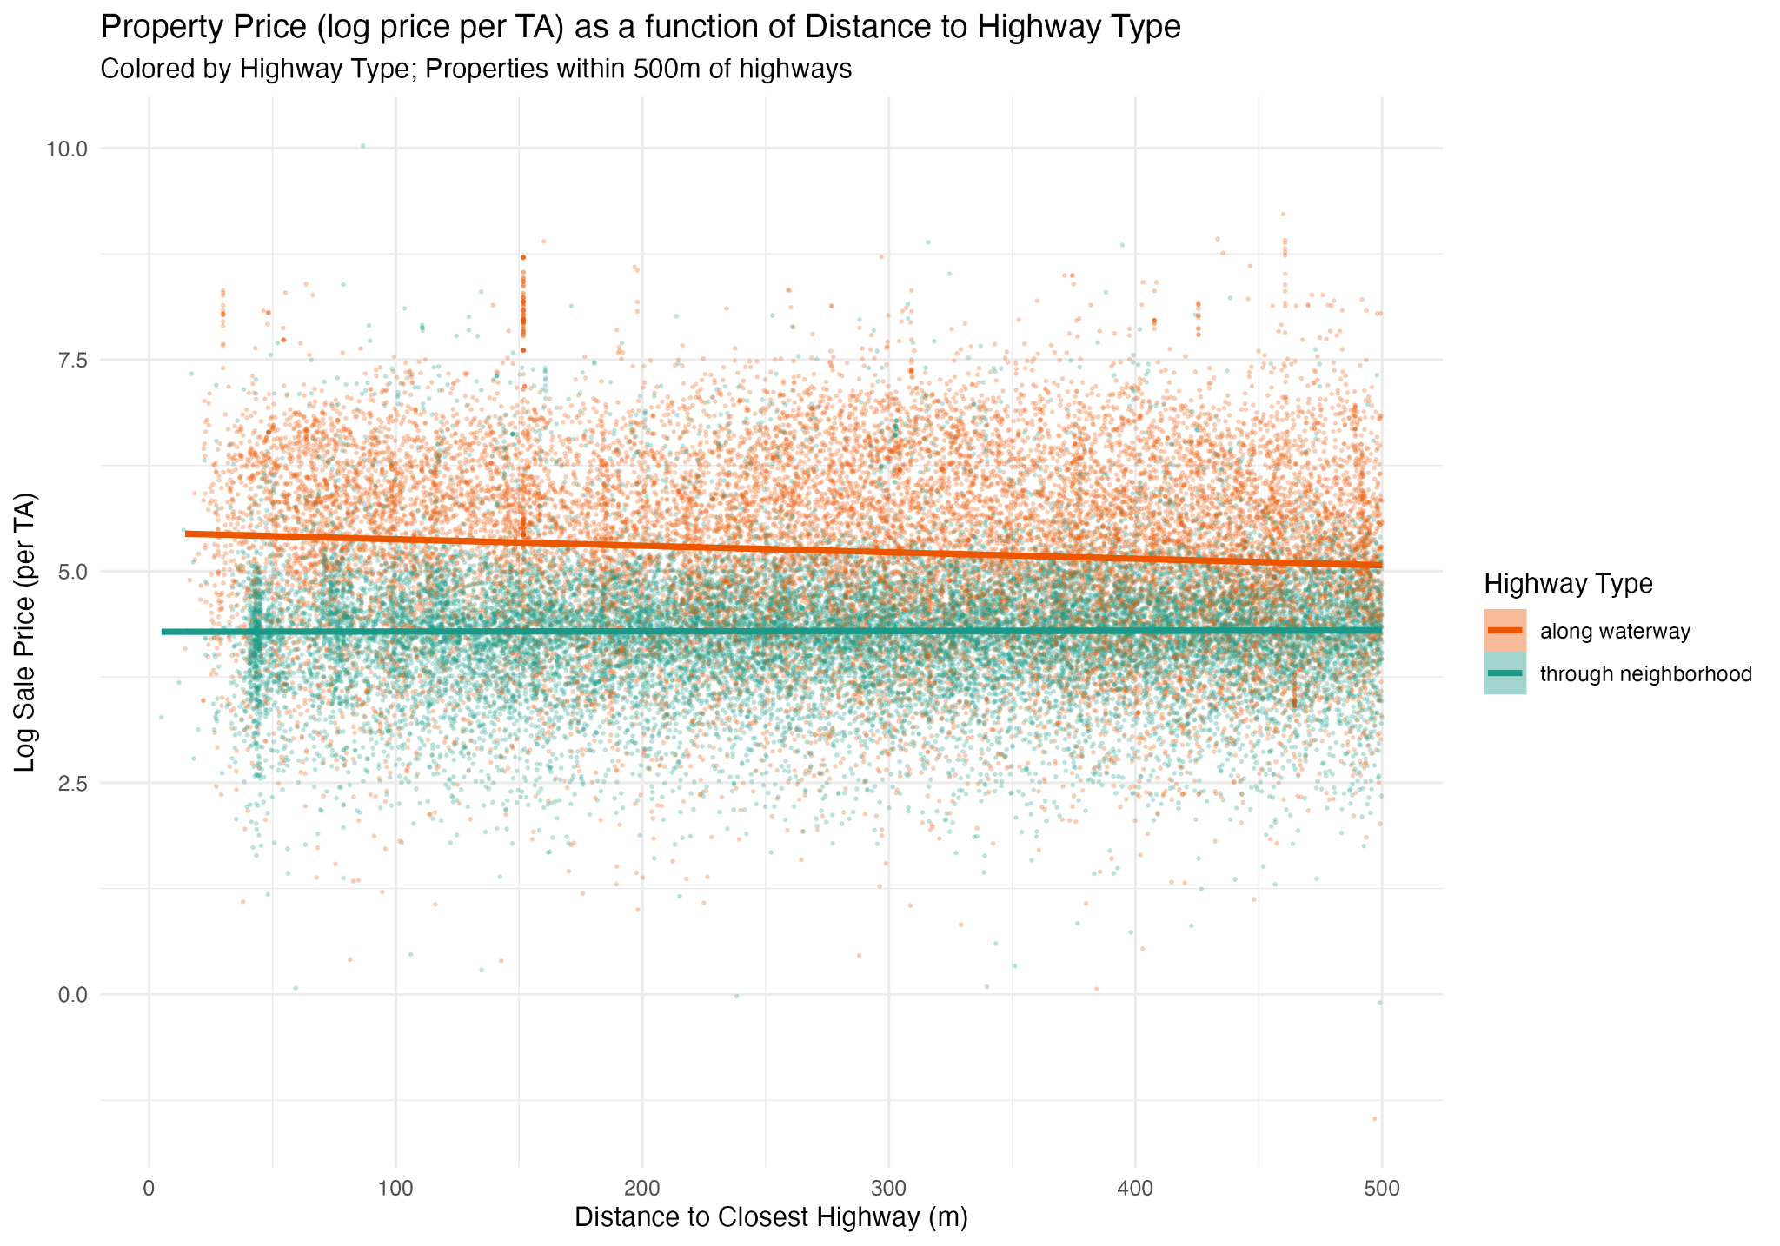
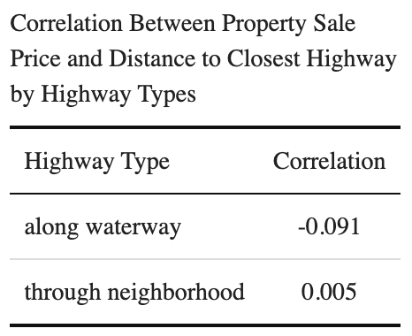
Case Studies - Highway effects on sales price
Notes:
Grouping I-76 and I-95 as highways that run along a waterway/natural line, and I-676 and US-1 as highways that cut through neighborhoods, we see a slight difference in the relationship between sale price and distance to closest highway.
For the prior group (along waterway in orange), the negative correlation is primarily driven by the negative correlation we saw in properties within 500m of I-95.
We don’t observe a strong relationship between sale price and distance to closest highway in the latter group (through neighborhods in teal), which enforces what we already know – distance to highway does not tell us the whole picture of what’s going on.
(Transition) So, what else do we know affects property sale price?

Slide 21
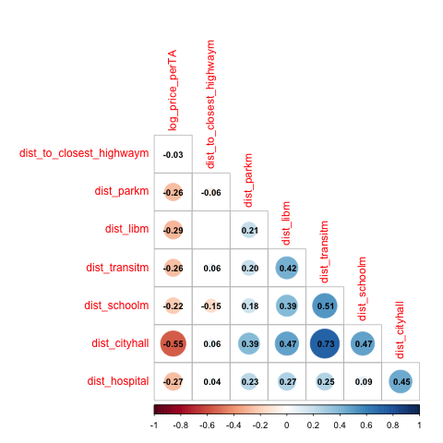
Case Studies
Notes:
Working within the same dataset (properties within 500m of highways in Philly), we also looked at correlation of sale price to distance to other amenities.
Compared to distance to other amenities, distance to closest highway seems to have a minimal negative effect on sale price overall. We see that distance to other amenities like parks, libraries, transit stops, schools, hospitals, and city hall are correlated much higher with sale price for properties within 500m of highways in Philly (with correlations spanning -0.22 to -0.55).

Slide 22
Exploratory Data Analysis
Basic Geography
Change in Chinatown
Effects of Highways
Discountinuity Effects

Slide 23
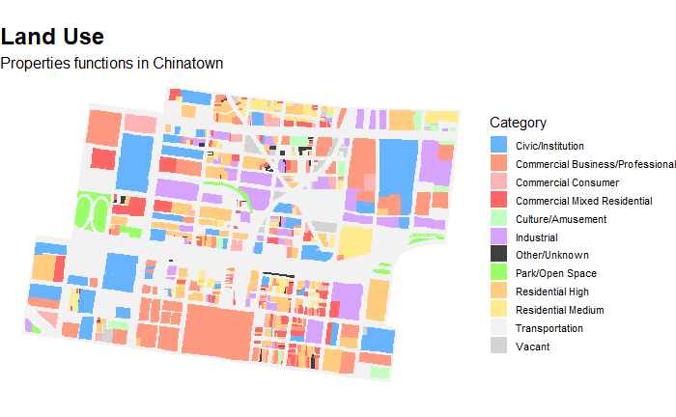
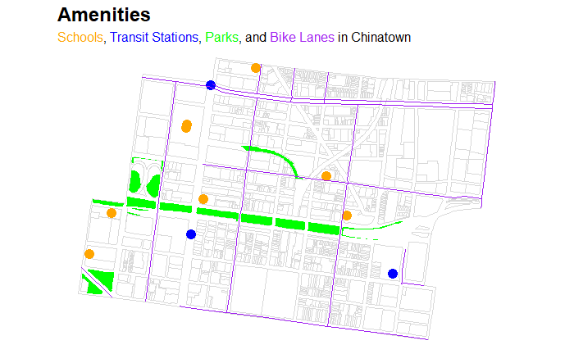
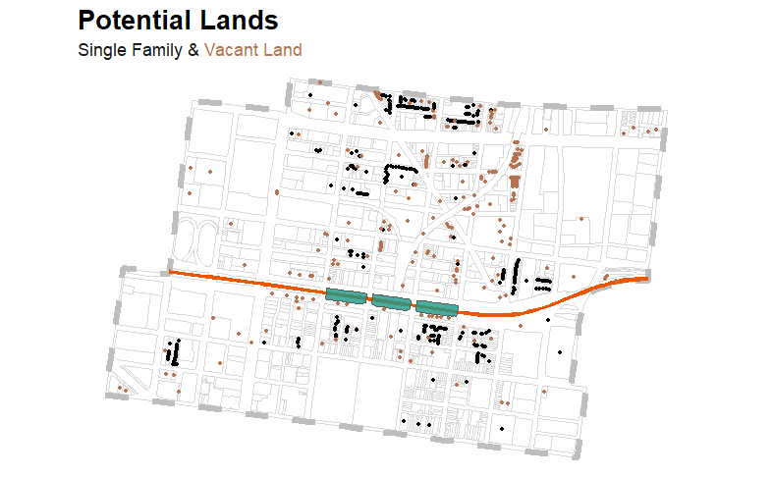
EDA: Basic Geography
Area north to the I-676 highway has more industrial land compared to the southern side which has a large portion of commercial land.
More schools are located north of the I-676, a few are right next to the highway.
A cluster of single-family homes and vacant lots is concentrated near the southern side of I-676, while the abundance of vacant land to the north suggests significant potential for future development.

Slide 24
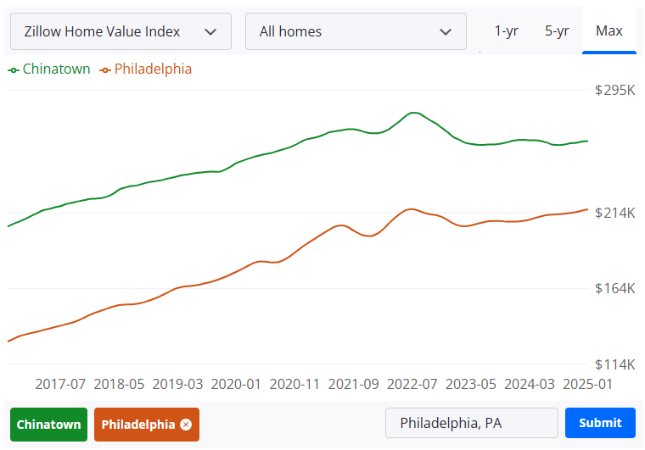
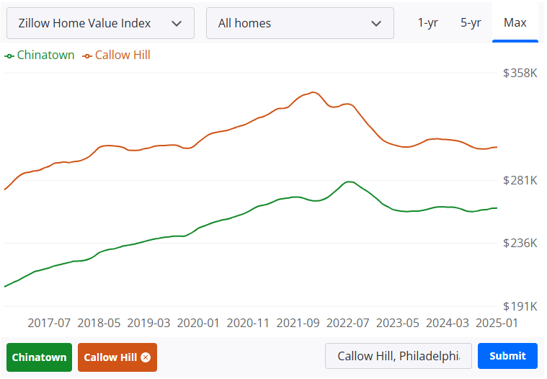
EDA: House Price Story of Chinatown
Chinatown vs. Philadelphia
Chinatown vs. Callow Hill
According to Zillow, the ZHVI (zillow home value index) is higher in Chinatown area than the rest of Philadephia in the past 8 years
Home values in Callow Hill had also been higher compared to Chinatown
Source: https://www.zillow.com/home-values/273240/chinatown-philadelphia-pa/

Slide 25
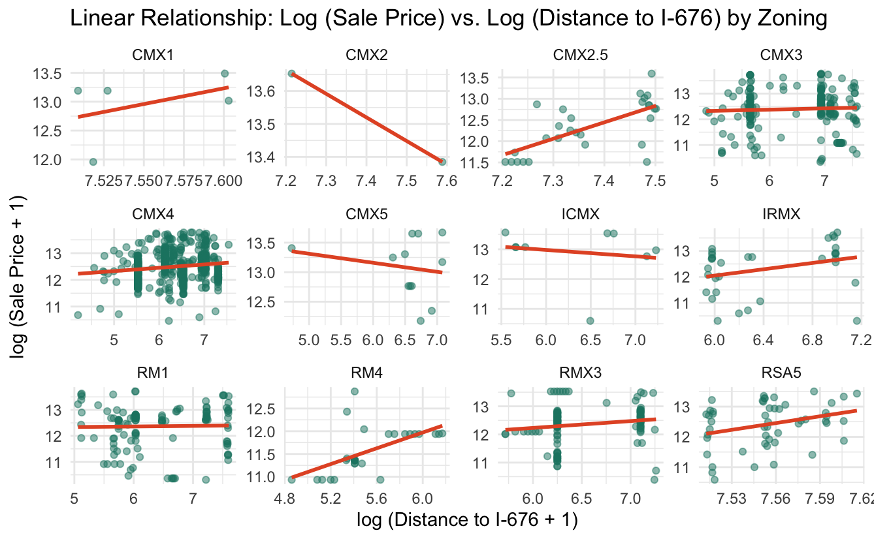
EDA: Highway effects on sales price
Different Zoning Exhibit Varying Sensitivity to the Highway
High-Density Commercial Use (CMX5, ICMX)
Residential Industrial Use (IRMX)
Residential Use (RM1, 4, RMX3, RSA5 )
Neighborhood Commercial Use ( CMX 2.5, 1, 2)
Community Commercial Use (CMX3, 4)
Notes:
Looking at sales price in relationship to different zoning types, we discovered that…
High density commercial areas (CMX5, ICMX) rely more on the highway, with higher property prices near it
This might suggest that commercial properties benefit from the traffic and accessibility that highways provide, increasing their value
Residential areas (RMX3, RM1, RM4, RSA5) tend to have higher prices further from the highway
This might indicate that people prefer living away from noise and pollution, making properties farther from the highway more desirable
Mixed-use areas (CMX2.5, 3, 4) show a positive correlation with distance
This might suggest both residential&commercial demand influence sale prices, and being farther from the highway might make these areas more livable

Slide 26
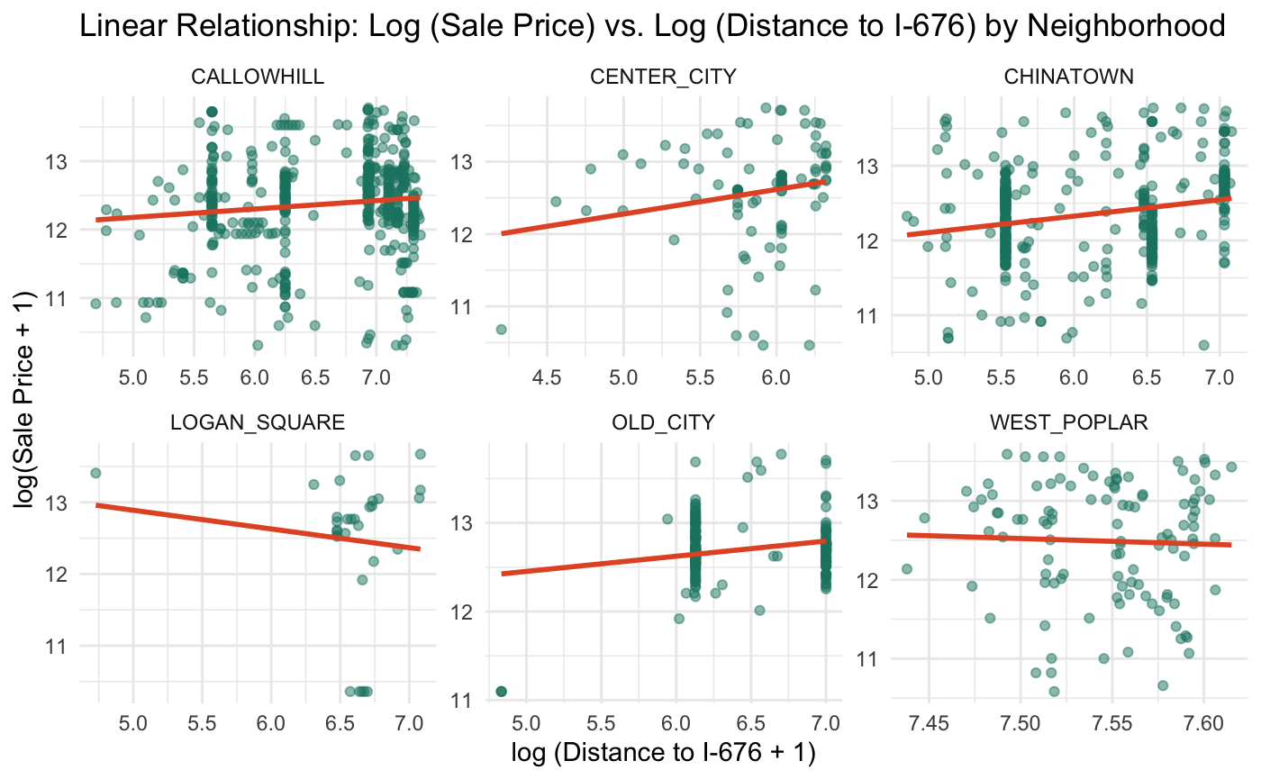
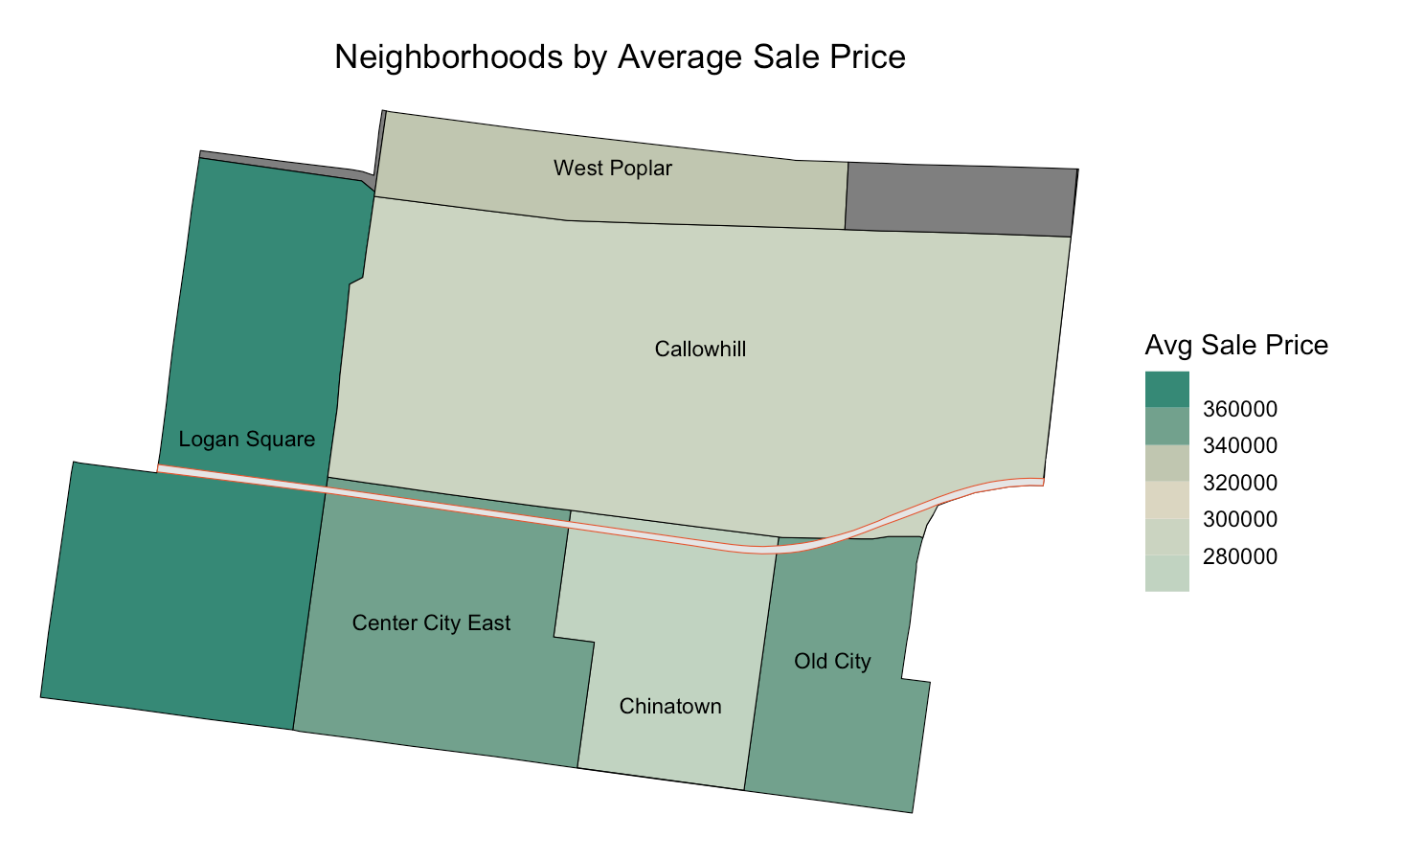
EDA: Highway effects on sales price
Different Neighborhood Exhibit Varying Sensitivity to the Highway
Chinatown, Center City, Old City, Callowhill
Logan Square, West Poplar
Notes:
Looking at sales price in relationship to different neighborhoods, we discovered that…
In commercial and mixed-use areas (Chinatown, Old City, Center City, Callowhill), property prices tend to be higher further from the highway.
This suggests that (noise and air) pollution from the highway may negatively impact these mixed-use areas. Also, walkability and proximity to the city center play a key role in driving up sale prices.
In residential areas (Logan Square, West Poplar), property prices tend to be higher closer to the highway.
Gentrification is likely influencing sale price increases in these areas.
There may be more commercial activity or new developments near I676, increasing property values
Rather than highway access, proximity to the city center seems to have a stronger influence on pricing in the neighborhoods.
From the first stage of sale price vs. zoning/ nhood analysis:
Further analysis should examine detailed land uses to determine whether sale prices are linked to specific commercial uses or developments.
Models should be built incorporating factors e.g. proximity to commercial areas, land uses, and pollution levels to quantify the impact of I676 on property values across different neighborhoods.
Future scenario planning should consider the diverse land uses and zoning in each community, to balance commercial development with residential needs to ensure sustainable urban growth

Slide 27
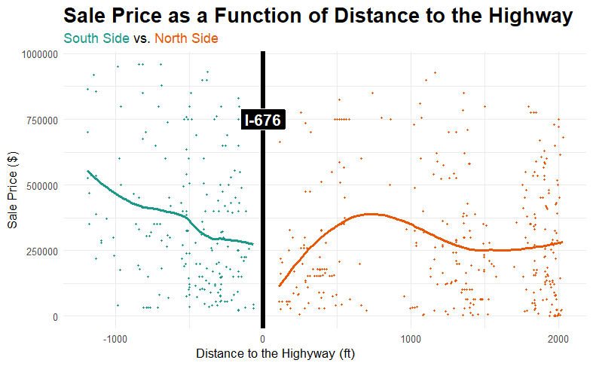
EDA: I-676’s Discontinuity Effects
I-676 influences sale prices in our study area, with prices rising as distance from the highway increases.
However, on the northern side, other factors seem to keep prices low.
Continued to explore in discontinuity models

Slide 28
Next Steps (as of Feb 25th)

Slide 29
Project Milestones
Jan 28 - Client Introductory Interview with OTIS
Feb 4 - Interview with Dr. Jefferey Lin
Feb 10 - Interview with Dr. Domenic Vitiello
Feb 18 - Interview with Professor Yadan Luo
Feb 20 - Check Up Meeting with OTIS
Feb 25 - In-Class presentation #1
Mar 4 - Scenario Planning Workshop with OTIS
Mar 18 - Models Completion
Mar 20 - Check Up Meeting with OTIS
Apr 1 - In-Class Presentation #2
Apr 24 - Check Up Meeting with OTIS
Apr 25 - Application Completion
May 6 - Final Presenation (3-4pm, let Micheal know)

Slide 30
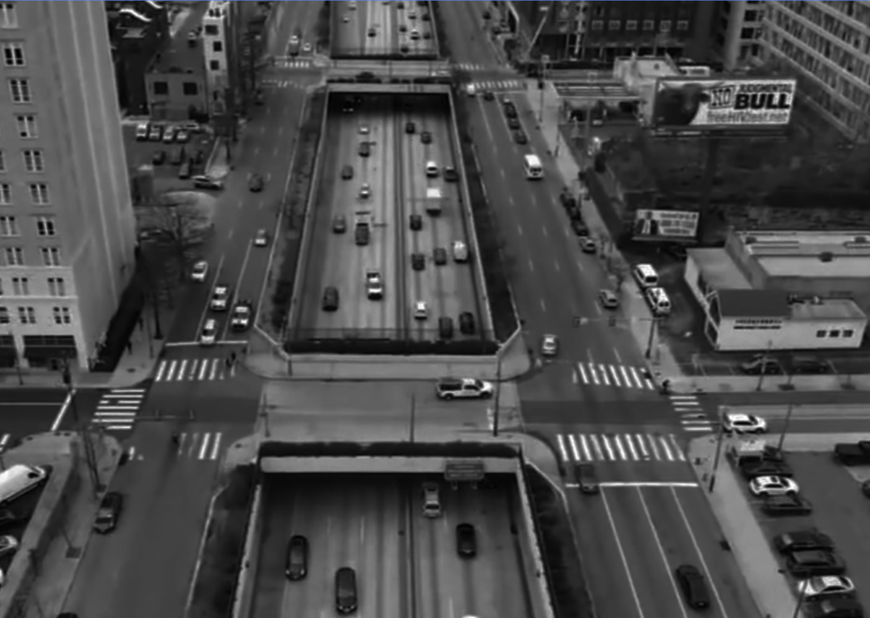
Thanks!
Instructors: Michael Fichman & Matthew Harris
Team: Aki Di Sandro, Ray Ma, Luming Xu, Sijia Zhang, Yixuan Zhou
Client Contacts: OTIS
Notes:
50% - reduce the information density, reduce the complexity, figure out what is the most important information - the most critical facts
geographic story, consistency, narrative, composition of the slides
reshape the discontinuity model to linear form, log value for casual observe to relate to the economic, simplify the plots
make the plot more interesting, dont make it look like R output graphic
Scatterplots - rejustify every graphic, reduce the amount, eventually going to be too much for the final presentation
Assign the same colors to each neighborhood throughout the presentation
Backup slides for more info, markdown is the place tha can go crazy
all randomized landuse and zoning

